Slide 2
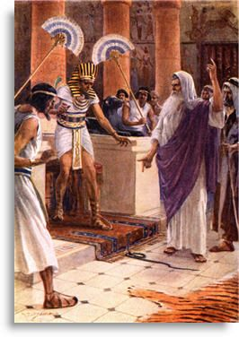
Learn a great deal by study of old testament
Romans 15:4

Slide 3
Things which God Hates and will not tolerate
The Things that please god and are acceptable to Him
How to avoid compromise of the truth

Slide 4
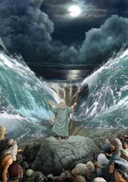
1 Corinthians 10:1-4
Passing through the red sea was a baptism
Galatians 3:26,27

Slide 5
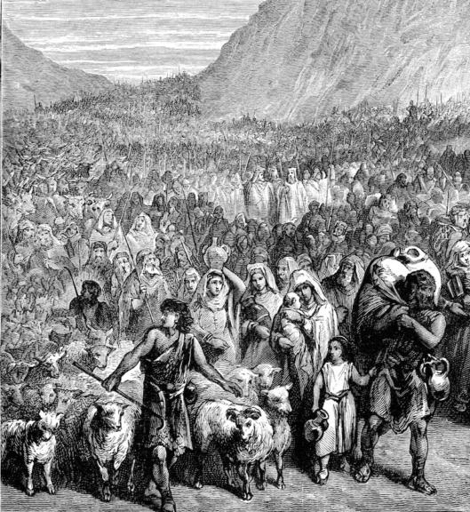
End of slavery and beginning of a new life
John 8:32-34

Slide 6
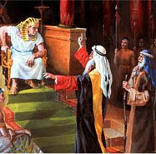
Exodus 5:2
Pharoah’s attitude was not humble or submissive
He ALWAYS wanted to keep Israel in bondage
Today, Satan is the same way with us in bondage to sin
He is full of deception, and we must not be fooled

Slide 7
Five compromises of Pharoah
  Exodus 5:1-9
  Moses came with God’s demand “Let My people go”
  Pharoah’s response (VS. 5-9)
  Make them TOO BUSY to want to be free

Slide 8
Five compromises of Pharoah
  Satan:
  “TOO BUSY for a Bible study”
  “TOO BUSY making a living”
  “TOO BUSY raising a family”
  “TOO BUSY in community activities”
  “TOO BUSY in a false religion”
  Learn to respond right way – Acts 16:14; 8:27,28
  No reason to be TOO BUSY for spiritual things

Slide 9
Five compromises of Pharoah
  Exodus 8:25 “Go, sacrifice…in the land.”
  The Egyptians would not have allowed it
  Satan entices us to do things that are good offerings to God, but STAY IN SIN!
  Many good things done by non-Christians
  May live a good moral life
  Say they are better than some Christians
  BUT they NEVER OBEY THE GOSPEL!

Slide 10
Five compromises of Pharoah
  What we must respond to this ploy:
  2 Thessalonians 1:7-9 NKJV 7 …the Lord Jesus is revealed from heaven with His mighty angels, 8 in flaming fire taking vengeance on those who do not know God, and on those who do not obey the gospel of our Lord Jesus Christ 9 These shall be punished with everlasting destruction from the presence of the Lord and from the glory of His power,”

Slide 11
Five compromises of Pharoah
  What we must respond to this ploy:
  WHO will be condemned?
  Those who OBEY NOT THE GOSPEL!
  Hebrews 5:8,9
  To WHOM is He the AUTHOR OF ETERNAL SALVATION?
  Those who OBEY HIM!
  Must urge people to GET OUT OF SIN and INTO CHRIST!

Slide 12
Five compromises of Pharoah
  Exodus 8:28 “Go…you shall not go very far”
  Satan willing to compromise with us
  Obey the truth, but never get much involved in working for the Lord
  Don’t grow very much, or you might learn to avoid me
  Never learn to teach others
  Be inconsistent
  Let’s grow up so we can overcome Satan!

Slide 13
Five compromises of Pharoah
  Exodus 10:7-11 “let the men go, but let the women and children stay behind with me.”
  Moses said ALL must go – Vs. 9,10
  Satan tempt husband/wife when spouse is not a Christian to compromise their faith and conduct
  Might be content to let one family member obey the Truth as long as he controls rest of family
  Use father/mother as excuse not to obey
  Get discouraged in old age by unfaithful children

Slide 14
Five compromises of Pharoah
  Exodus 10:24 “let your flocks/herds be kept back”
  Keep all their possessions!
  Satan may allow us to obey Gospel, and teach our children, but he wants our possessions
  Car goes anywhere, anytime – but somehow can never make it to the assemblies
  Cars hauls sports participants, family picnic, but never once carry a visitor to assembly
  Bank account plenty; but only a little for Sunday

Slide 15

Let’s convert our possessions and use everything we have in god’s service

Slide 16
Satan’s final destiny is prepared
  Revelation 20:10 “The devil, who deceived them, was cast into the lake of fire and brimstone…”
  Matthew 25:41 “Then He will also say to those on the left hand, 'Depart from Me, you cursed, into the everlasting fire prepared for the devil and his angels:”
  What Compromise Are You Making To Avoid Becoming Free From Sin?
  Why not obey the Gospel right now?

